Slide 1

Basic Details of the Team and Problem Statement
N. B. Navale Sinhgad College of Engineering , Solapur.
Problem Statement Title: Leaf disease detection
Group No. : G-04 Team Name: Team 404
Team Leader Name: Mustafa Masuldar
Project Guide : Prof. S. S. Shelke
Subject Name : Predictive Analysis

Slide 2
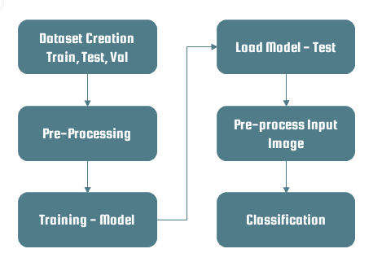
Idea/Approach Details
Describe your idea/Solution/Prototype here:
Vision: Leading the way in plant health solutions, creating a future where thriving, disease-free crops sustain global food security and environmental well-being.
Mission: Our mission is to Developing technology for early disease detection, promoting sustainable agriculture, and ensuring global food security.
Forecasting of plant leaf disease (Quantification) as soon it appears on plant leaves.
Automatic detection technique is used it will take less efforts, less time and more accurately. In plants, some general diseases are brown and yellow spots, or early and late scorch, and other fungal, viral and bacterial diseases.
Increase accuracies Using large dataset to train the Algorithm and maximize epoch values.
Other than plant leaf disease identification, it can also be used for identification and classification of nutrients deficiency of plant leaves.
Describe your Technology stack here:
Python 3
Dataset ( plants disease )
Python libraries (opencv,numpy,pandas,etc.)

Slide 3
Idea/Approach Details
Describe your Use Cases here
Describe your Dependencies / Show stopper here
Early Disease Detection:
Identify and diagnose plant diseases at an early stage, allowing farmers to take timely action to prevent the spread of diseases and minimize crop damage.
Precision Agriculture:
Implement targeted disease control measures by identifying affected areas within a field, reducing the need for widespread pesticide application.
Smart Farming:
Farmer's economic growth depends on the quality of the products that they produce, which relies on the plant's growth and the yield they get.
Therefore, in ﬁeld of agriculture, detection of disease in plants plays aninstrumental role.
Dependencies
Internet Access.
Training Data Quality.
User Interaction
Image Data
Machine Learning Frameworks
Show stopper
Inadequate Training Data
Computational Resource Limitations
Model Complexity
Internet Outages
Data Privacy Concerns
Model Accuracy
User Training

Slide 4
Team Member Details
Team Leader Name : Mustafa Masuldar
Branch : Btech Stream : CSE Year : IV
Team Member 1 Name : Sakshi Deshmukh
Branch : Btech Stream : CSE Year : IV
Team Member 2 Name : Pooja Pawar
Branch : Btech Stream : CSE Year : IV
Team Member 3 Name : Nandini Madre
Branch : Btech Stream : CSE Year : IV
Team Member 4 Name : Iram Muchale
Branch : Btech Stream : CSE Year : IV

